Slide 1
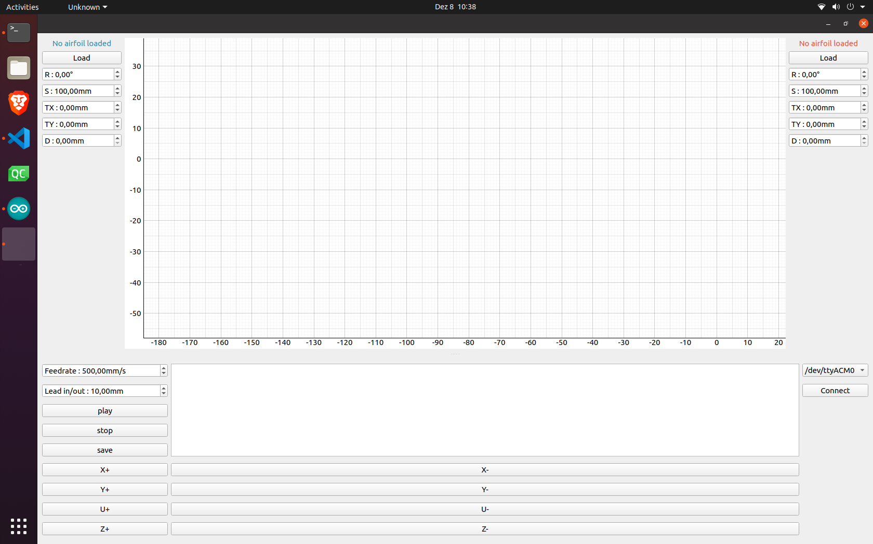
This is the user interface that is shown when you start the machine. There are a few modifications to make, such as the jogging buttons are too large. However, functionally, everything is working.
Here you have your two profiles that can be loaded. You can modify the R (rotation), S (size, or length), TX (x-axis offset), TY (y-axis offset), and D (diameter, or width)
Here is where you connect to the Arduino serial port
When you hit play, the gcode will populate this empty white box
These are your jogging buttons. You can jog any of the four motors in + or – direction.

Slide 2
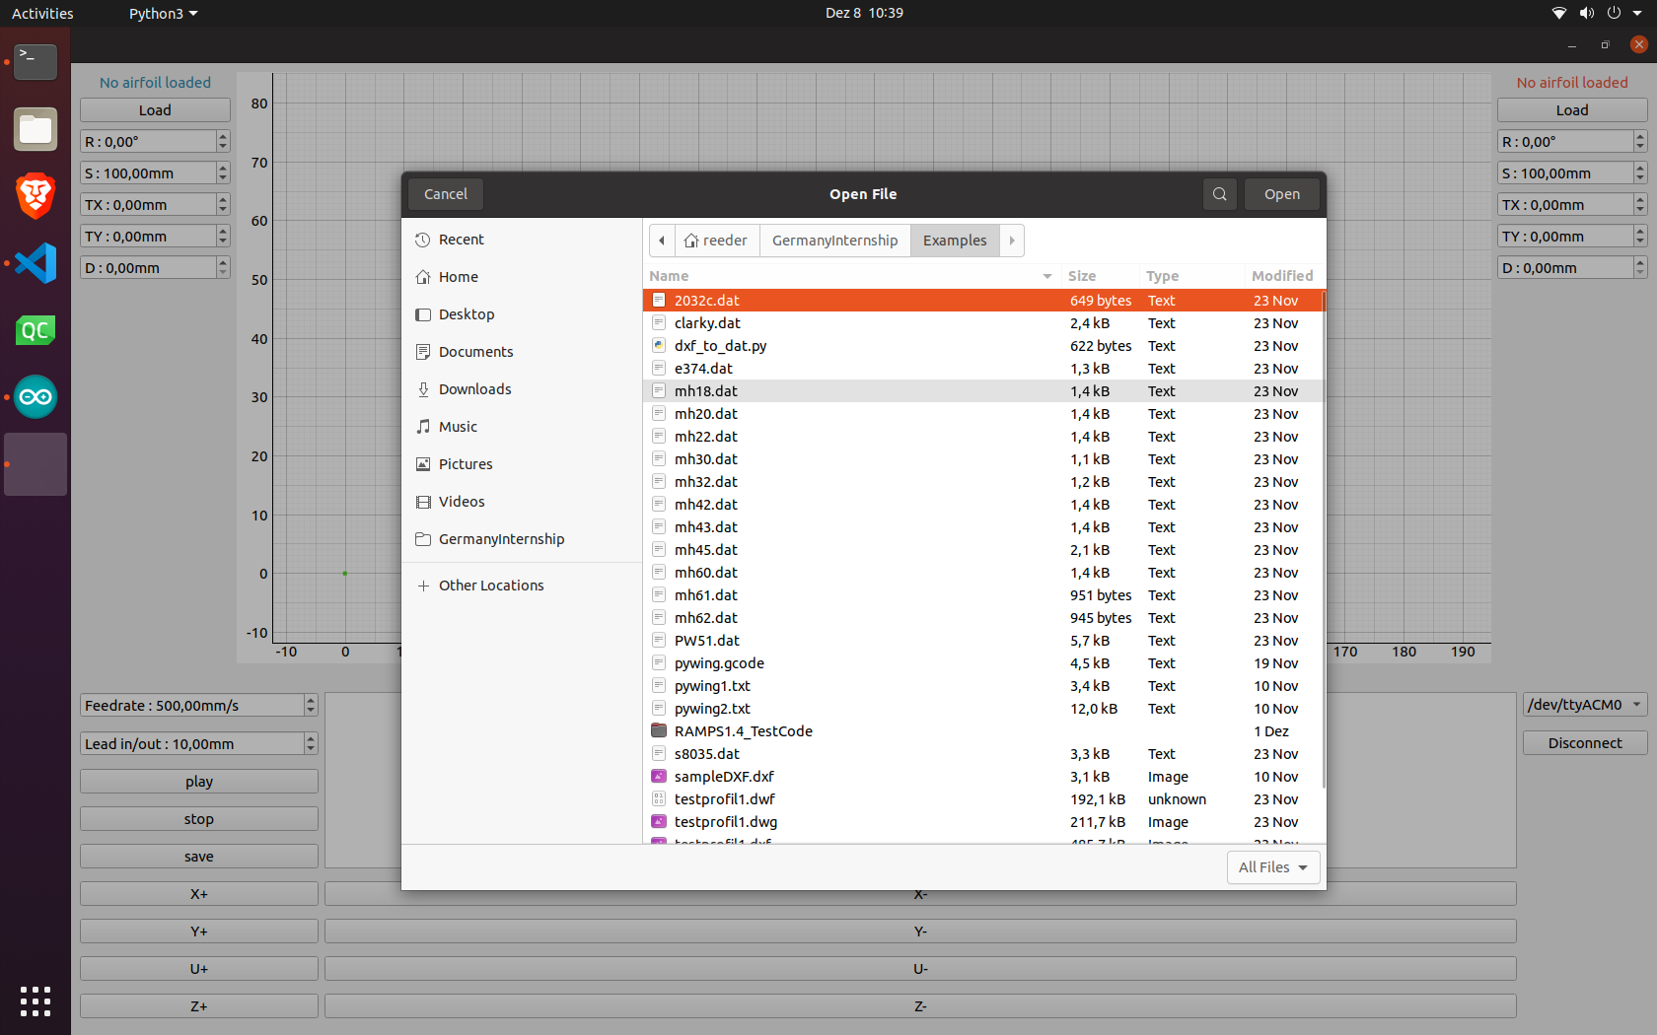
When you hit the Load button, a file dialog appears, and you can load *.dat/*.txt (coordinate) files. I am looking into importing other files, such as *.dxf and *.stl, however it will take some work since they have proprietary tags in their coordinates to untangle. I think most cad softwares can export a list of coordinates into a text file.

Slide 3
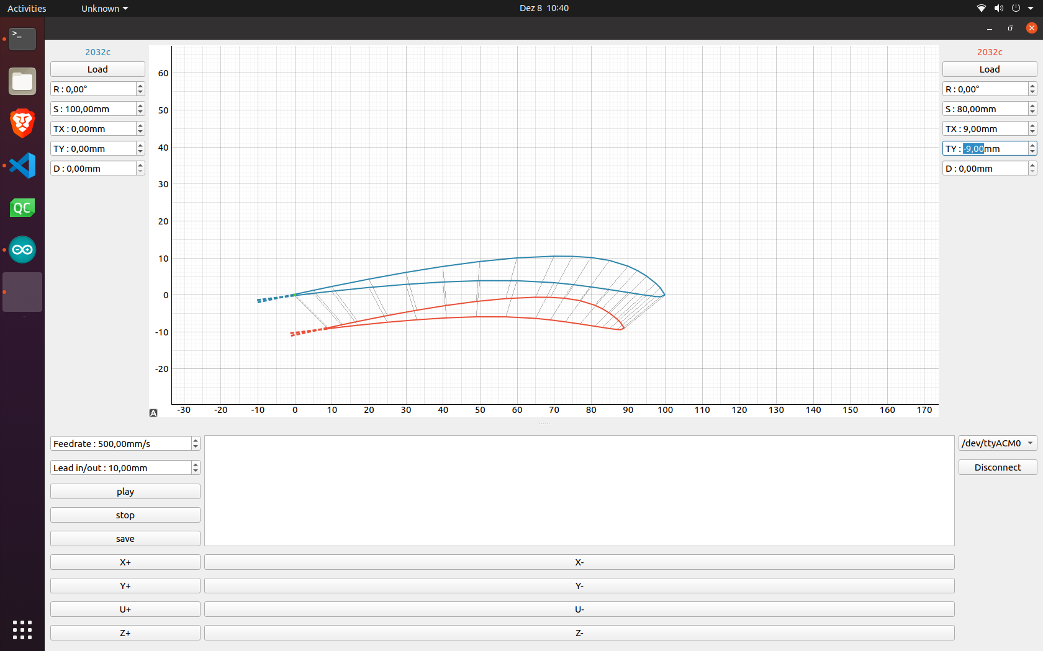
Once you open the two profiles, one will be highlighted in blue and the other in red. As you can see, you can move/modify the profile with the controls to make tapered wings.
Here, you can set the speed of the motors (feedrate) and the length to cut into the foam before starting the profile (lead in/out), which is represented by the dotted line on the profile.

Slide 4
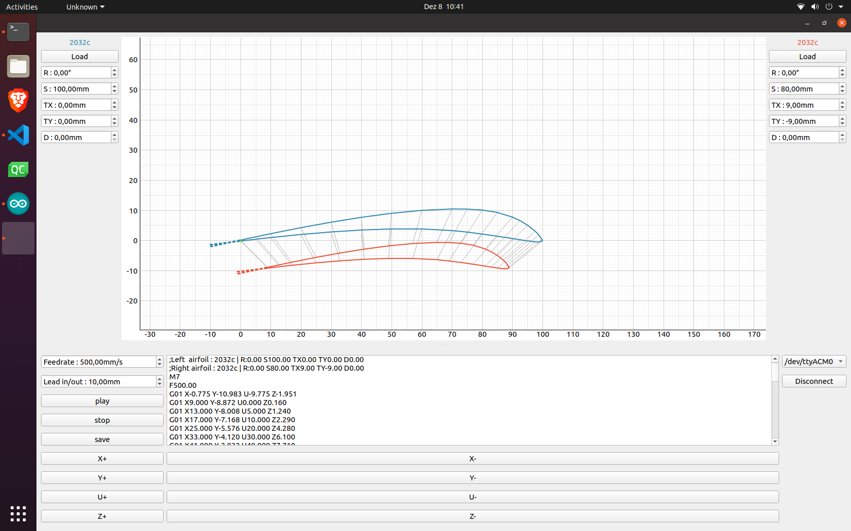
When you complete your wing profile modifications, you then jog the motors to the zero position. You then set your zero (I am making a button for that today), and press play. The gcode appears in the white box and starts immediately.

Slide 5
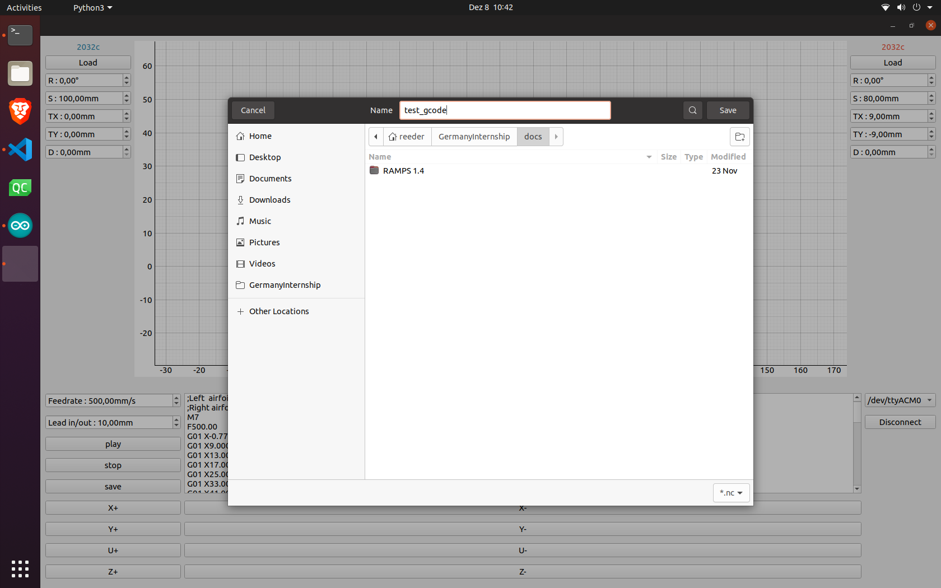
You type in the name of the file and press save on the dialog.
You can save the generated gcode for future use, into a *.nc file.
Simply press the save button and a file dialog appears.

Slide 6
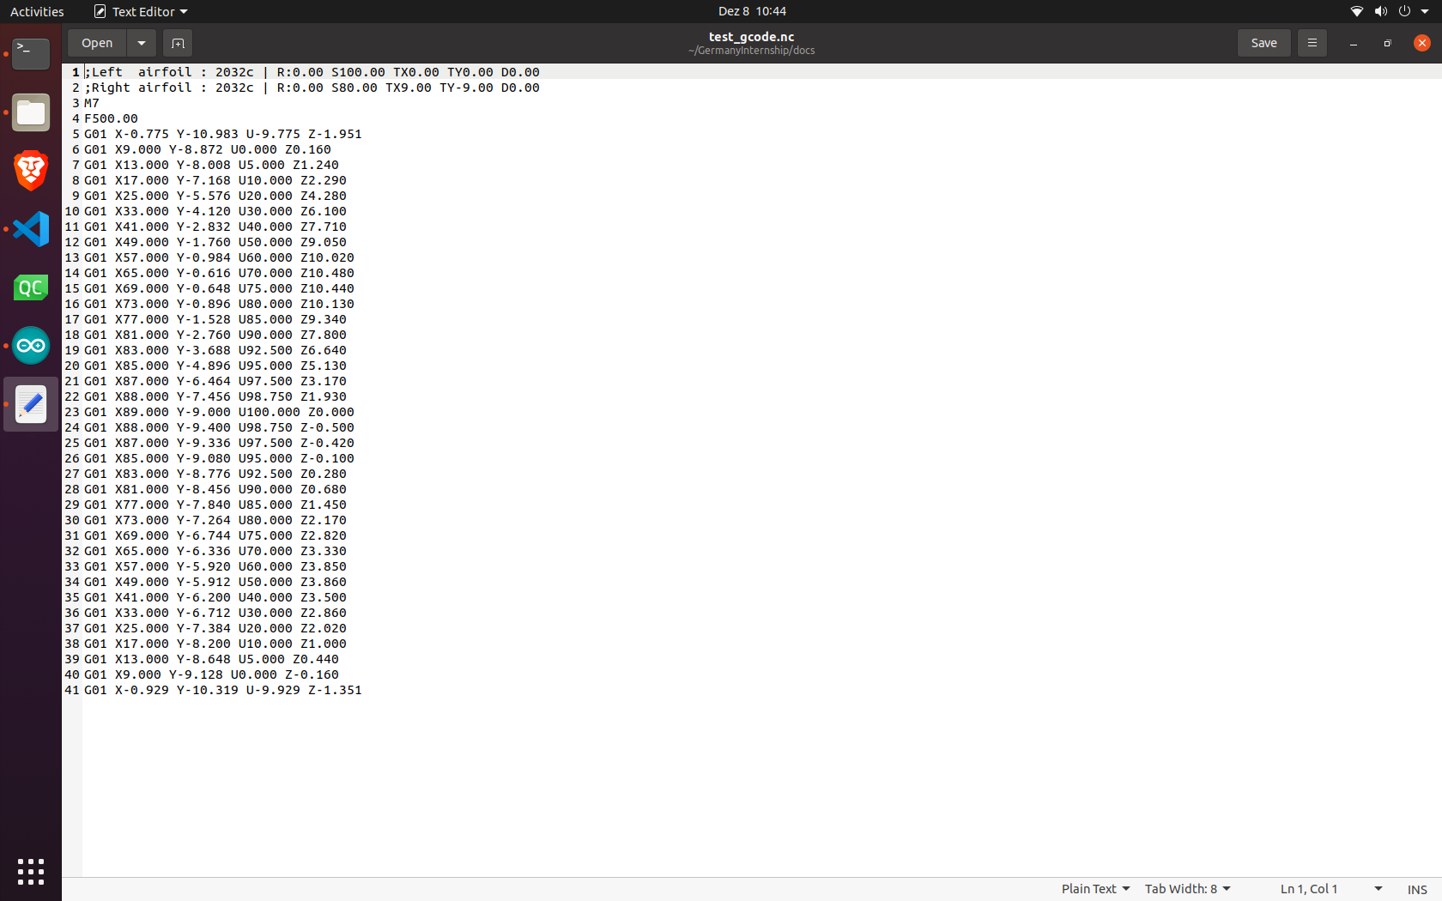
You can then navigate to the directory where you saved the gcode to view and edit the gcode as needed. I will make an import button on the interface to load gcode files, not just wing profiles, into the software.

